Slide 1
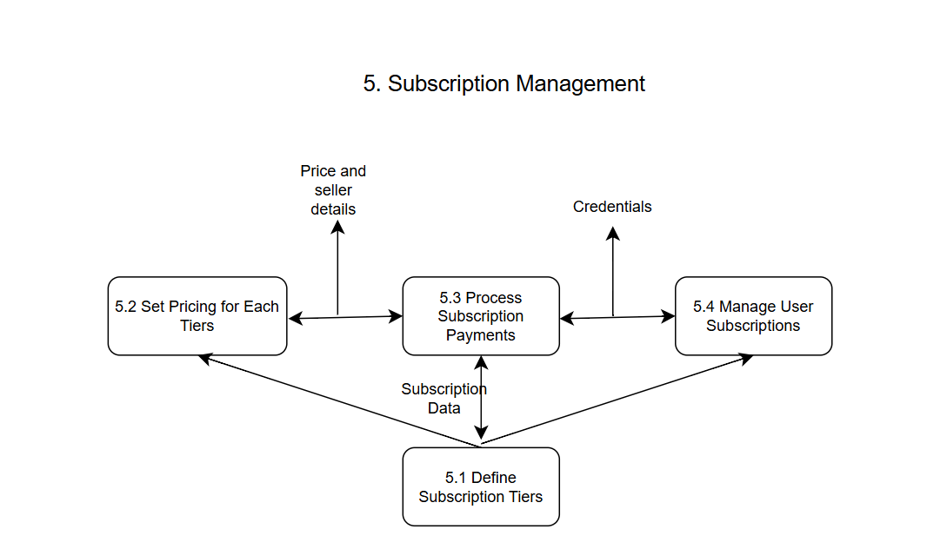
Freelance Forge: Data Flow Diagram (Logical)
5. Subscription Management

Slide 2
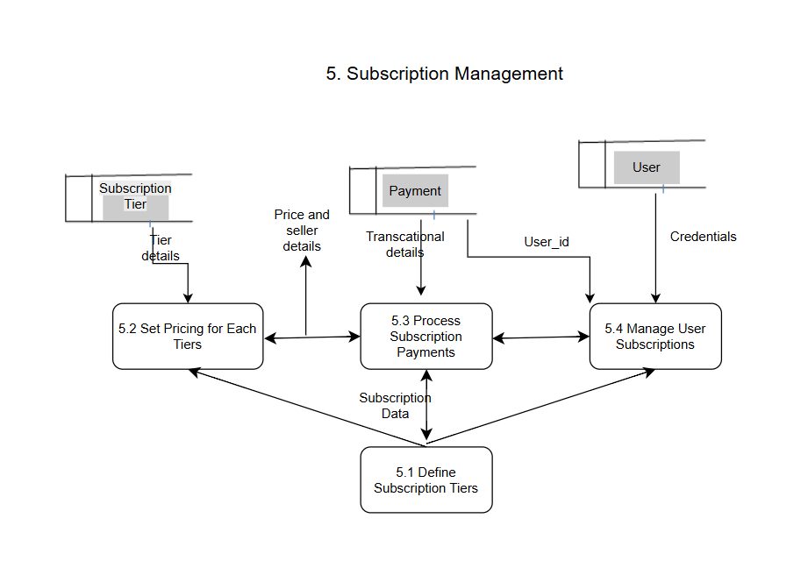
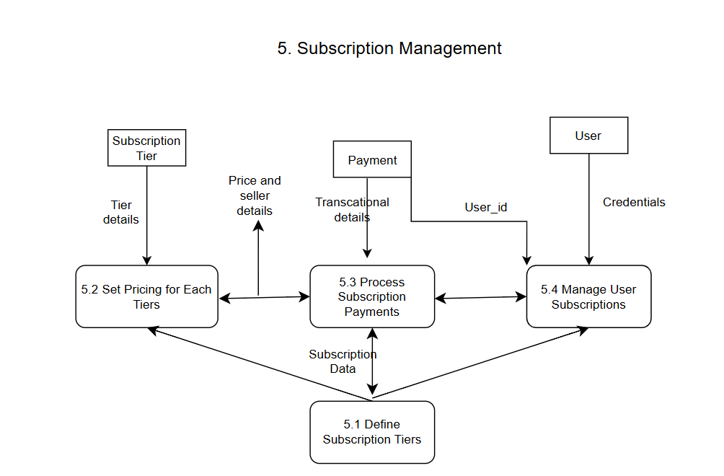
Freelance Forge: Data Flow Diagram (Physical)
5. Subscription Management

Slide 3
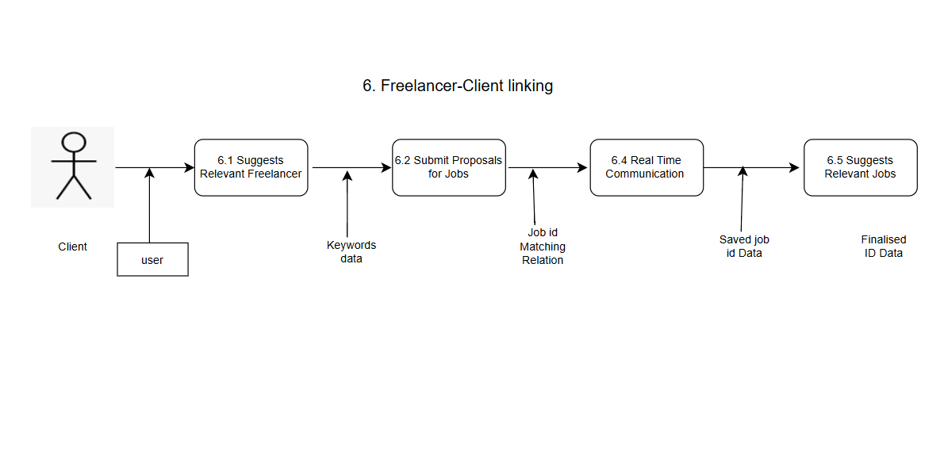
Freelance Forge: Data Flow Diagram (Logical)
6. Freelancer-Client linking

Slide 4
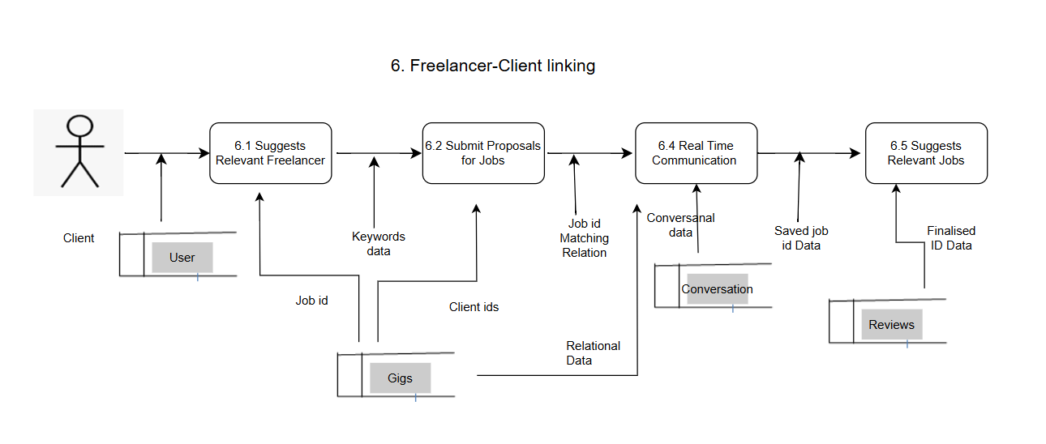
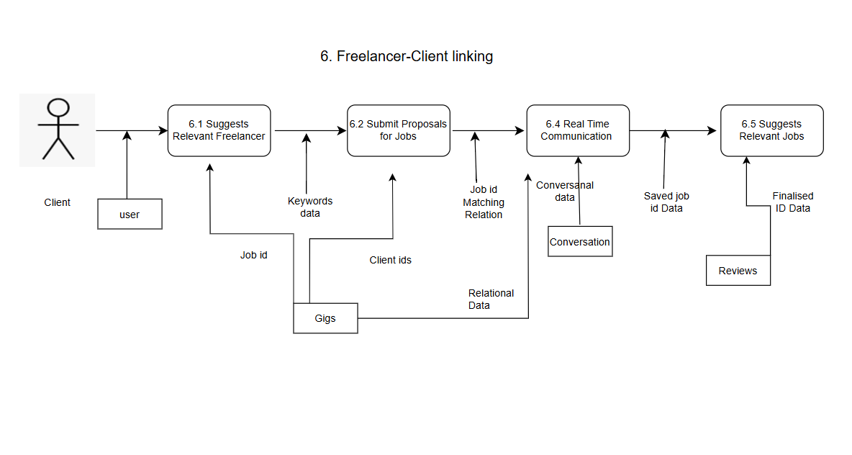
Freelance Forge: Data Flow Diagram (Physical)
6. Freelancer-Client linking

